Slide 1
UNIT-3 Multiprocessor and Multicore Operating Systems
OPERATING SYSTEM CONCEPTS
UNIT-3
Multiprocessor and Multicore Operating
Systems

Slide 2
Multiprocessor and Multicore Operating Systems
Multiprocessor Operating System refers to the use of two or more central processing units (CPU) within a single computer system.
The difference between multicore and multiprocessor is that multicore refers to a single CPU with multiple execution units, while multiprocessor refers to a system that has two or more CPUs. Modern computers have multiple CPUs each with multiple cores.

Slide 3
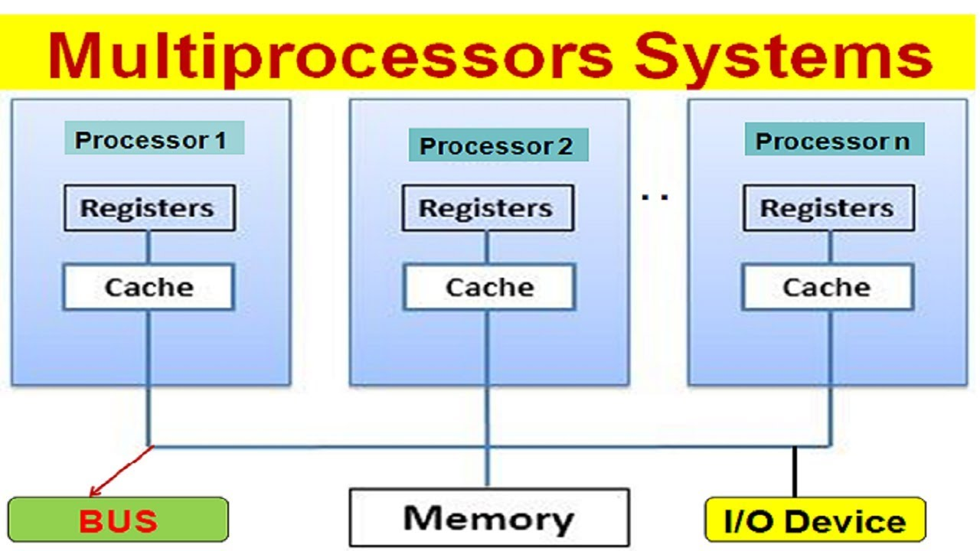

Slide 4
Multiprocessor operating systems
Multiprocessor operating systems are the server operating systems with special features for the communication and the connectivity.
Multiprocessor operating systems are used where multiple CPUs connected into a single system.
Multiprocessor operating system (OS) is almost a regular OS as they also handle system calls, do memory management, provide file system, and also manage input/output devices.
But, there are some extra features available in multiprocessor operating systems, those extra features :
Process synchronization
Resource management
Scheduling

Slide 5
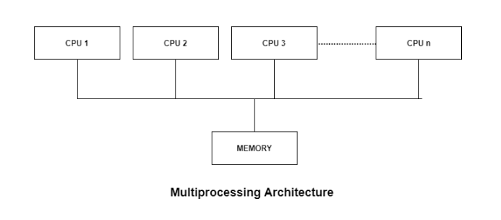
Multiprocessor Architecture
These types of systems are used when very high speed is required to process a large volume of data. These systems are generally used in environment like satellite control, weather forecasting etc.

Slide 6
Advantages of Multiprocessor Systems
High Throughput: Throughput is the number of processes executed by the CPU at a given time so this type of system has higher throughput.
Type of parallel processing: Parallel processing means the execution of multiple processes (also known as threads) at the same time.
Less electricity usage: In a single processor system, there is more load as many processes have to be executed at a time. But in multiprocessor system execution of multiple processes in done in a few times. That means multiprocessor CPUs consume low electricity than a single processor.
High Reliability: As multiple processors share their work between one and another so work is completed with collaboration. That means these systems are reliable.
Economic: As more work is completed by the CPU’s so these systems are economically good as well.

Slide 7
disadvantages of Multiprocessor Systems
Communication: As multiple processors are communicating with each other so the operating system implementation is complex to handle.
More memory required: As there are multiprocessors working with each other so each processor needs memory space.
Deadlock: If any processor is already using the I/O device then other processors cannot use the same I/O device which creates deadlock.
Performance: If any processor fails to work then the work is divided into other processors. The bad effect will be that work will be completed in high time and the performance of the system is affected.
Expensive: These type of systems are expensive to buy.

Slide 8
Types of Multiprocessors
Symmetric Multiprocessors
In these types of systems, each processor contains a similar copy of the operating system and they all communicate with each other. All the processors are in a peer to peer relationship i.e. no master - slave relationship exists between them.
An example of the symmetric multiprocessing system is the Encore version of Unix for the Multimax Computer.
Asymmetric Multiprocessors
In asymmetric systems, each processor is given a predefined task. There is a master processor that gives instruction to all the other processors. Asymmetric multiprocessor system contains a master slave relationship.
Asymmetric multiprocessor was the only type of multiprocessor available before symmetric multiprocessors were created. Now also, this is the cheaper option.

Slide 9
Basic Multicore Concepts
A single computing component with multiple cores (independent processing units) is known as a multicore processor. It denotes the presence of a single CPU with several cores in the system. Individually, these cores may read and run computer instructions.
A multi-core processor is a microprocessor on a single integrated circuit with two or more separate processing units, called cores (for example, dual-core or quad-core), each of which reads and executes program instructions.

Slide 10
Basic Multicore Concepts
Features | Multiprocessors | Multicore
Definition | It is a system with multiple CPUs that allows processing programs simultaneously. | A multicore processor is a single processor that contains multiple independent processing units known as cores that may read and execute program instructions.
Execution | Multiprocessors run multiple programs faster than a multicore system. | The multicore executes a single program faster.
Reliability | It is more reliable than the multicore system. If one of any processors fails in the system, the other processors will not be affected. | It is not much reliable than the multiprocessors.
Traffic | It has high traffic than the multicore system. | It has less traffic than the multiprocessors.
Cost | It is more expensive as compared to a multicore system. | These are cheaper than the multiprocessors system.
Configuration | It requires complex configuration. | It doesn't need to be configured.

Slide 11
Basic Multicore Concepts: Memory Sharing Styles
All multi-core microprocessors use an interconnection bus and share the main memory.
The programming model used is what is known as a shared memory programming in which a program to be executed is stored in the memory shared by all the cores.
Multi-core microprocessor is an interconnected set of independent processors called cores integrated on a single silicon chip.
These processing cores communicate and cooperate with one another to execute one or more programs faster than a single core processor.

Slide 12
Uniform Memory Access (UMA)
UMA Multiprocessor stands for “Uniform Memory Access Multiprocessor”. In which, it allows to access all memory at the uniform speed rate for all processors.
Uniform memory access (UMA) is a type of network architecture that enables all processors to equally use memory chips for storage and for processing.
While there typically are many processors in a network, each processor is granted the same access as every other processor in the system.

Slide 13
Non-Uniform Memory Access (NUMA)
Non-Uniform Memory Access (NUMA) is a computer memory design used in multiprocessing, where the memory access time depends on the memory location relative to the processor.
In NUMA, where different memory controller is used.
Non-uniform Memory Access is faster than uniform Memory Access.
Non-uniform Memory Access is applicable for real-time applications and time-critical applications.
Non-uniform memory access (NUMA) is a kind of memory architecture that allows a processor faster access to contents of memory than other traditional techniques. In other words, in a NUMA architecture, a processor can access local memory much faster than non-local memory.

Slide 14
No Remote Memory Access (NORMA)
No Remote Memory Access (abbreviated as NoRMA) is a computer memory architecture for multiprocessor systems
In a NoRMA architecture, the address space globally is not unique and the memory is not globally accessible by the processors.
Accesses to remote memory modules are only indirectly possible by messages through the interconnection network to other processors, which in turn possibly deliver the desired data in a reply message.
The entire storage configuration is partitioned statically among the processors.

Slide 15
Cache Coherence
In computer architecture, cache coherence is the uniformity of shared resource data that ends up stored in multiple local caches. When clients in a system maintain caches of a common memory resource, problems may arise with incoherent data, which is particularly the case with CPUs in a multiprocessing system.
Cache coherence refers to the problem of keeping the data in these caches consistent.
The main problem is dealing with writes by a processor.
There are two general strategies for dealing with writes to a cache: Write-through - all data written to the cache is also written to memory at the same time
As multiple processors operate in parallel, and independently multiple caches may possess different copies of the same memory block, this creates cache coherence problem. Cache coherence schemes help to avoid this problem by maintaining a uniform state for each cached block of data.

Slide 16
Inter-Process Communication
Inter process communication (IPC) is a mechanism which allows processes to communicate with each other and synchronize their actions. The communication between these processes can be seen as a method of co-operation between them.
Processes can communicate with each other through both: Shared Memory. Message passing.
As a result of extensive send-receive style of communication taking place between processors requesting a data and the remote processor owning the data, remote memory accesses incur a high bandwidth overhead.
Interprocess communication (IPC) refers specifically to the mechanisms an operating system provides to allow the processes to manage shared data.

Slide 17
Intercore Communication
Cores may or may not share caches, and they may implement message passing or shared-memory inter-core communication methods.
As threads communicate via a shared cache or main memory, thread communications depend on cache coherence mechanisms resulting in demand-based data transfers among threads.
In a multicore processor, each core has a small cache to store its frequently used data. There's also a large shared cache for the whole processor. All the cores of the processor can gain access to this shared memory. Since a number of cores may work simultaneously on the shared data.
When communicating tasks execute on the same core, the communication typically happens through the local cache.
On the other hand, when they run on separate cores, the communication has to go through the shared memory. As the shared memory has a significantly larger latency than the local cache.

Slide 18
Shared Memory & message passing
The process executing in the OS may be either independent process or co-operating process. Co-operating process require an IPC mechanism to communicate with each other.
Principally communication can be achieved through two schemes.
1 Shared Memory
2. Message Passing
Independent process cannot affect or be affected by the execution of another process
Cooperating process can affect or be affected by the execution of another process
The shared memory method requires communicating process to share some variables.
The process is expected to exchange information through the use of these shared variables by reading and writing data on shared memory.

Slide 19
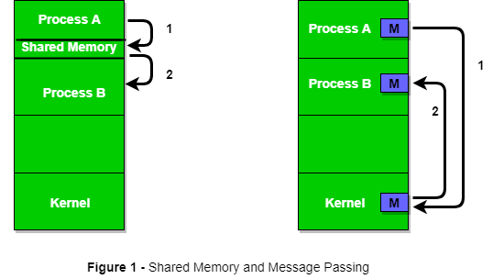

Slide 20
Shared Memory System
IPC using shared memory requires communicating process to establish a region of shared memory.
They can exchange the information through reading-writing.
The processes are also responsible for ensuring that they are not writing to the same location simultaneously.
Illustration by Producer consumer problem:-
Paradigm for cooperating processes, producer process produces information that is consumed by a consumer process

Slide 21
Producer consumer problem
A producer process produces information that is consumed by a consumer process.
We generally think server as producer and client as consumer. Usage : HTML, image etc.
To allow producer and consumer to run concurrently we must have available buffer of items that can be filed by producer and emptied by the consumer.
This buffer will reside in a region of memory that is shared by both.
A producer can produce one item while the consumer is consuming another item.
The producer and consumer must be synchronized so that the consumer does not try consume an item that has not been produced.

Slide 22
Producer consumer problem
unbounded-buffer places no practical limit on the size of the buffer
Consumer may have to wait for the new items, but producer can always produce new items.
bounded-buffer assumes that there is a fixed buffer size
The consumer must wait if buffer is empty and producer must wait if buffer is full.

Slide 23
Message Passing
It allows processes to communicate and synchronize their actions without sharing the same address space.
It is beneficial in a distributed environment where the communication may reside on different computers connected by network.
Example: Yahoo Chat:- A message passing facility provides at least two operations: Send (Message), Receive (Message)
Message can be fixed length (Programmer difficulty) or variable length
( More complex level implementation)
For IPC a communication link must exist between them. This link can be implemented in a variety of ways.
Here are several method for logical implementation of a link and send () / receive () operations:-
Direct or Indirect
Synchronous or Asynchronous
Automatic or Explicit Buffering

Slide 24
Thank You
Have a Good Day!

